Slide 1
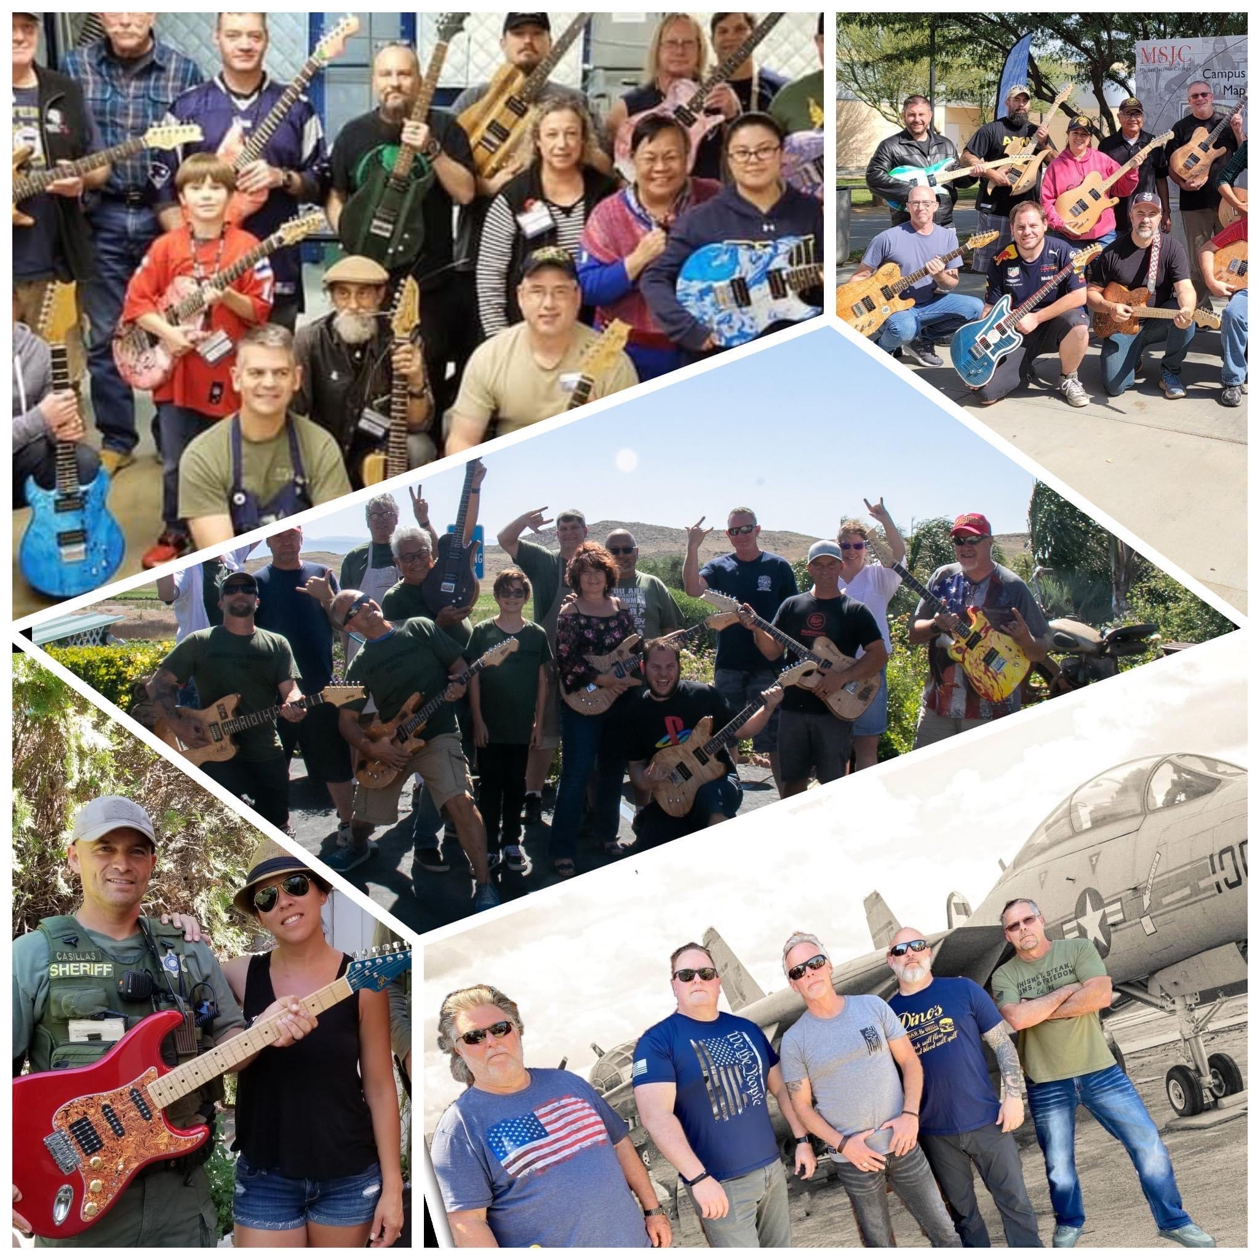
AMERICAN PATRIOT MUSIC PROJECT
“MUSIC THERAPY SUPPORT FOR VETERANS AND FIRST RESPONDERS”

Slide 2
AGENDA
Background
Mission
Programs
American Patriot Band
Metrics
Contact Info

Slide 3
BACKGROUND
American Patriot Music Project (APMP) is a 501c3 non-profit organization (Tax ID 83-1662962).
Founded in 2018 by a retired Navy SEAL Veteran
Headquartered in Temecula, California
Administration (Board of Directors)
Includes the award-winning signature band AMERICAN PATRIOT BAND

Slide 4
MISSION
Provide Music Therapy Support to military veterans and first responders by facilitating a variety of music projects in order to positively influence the lives of our nation’s HEROES.

Slide 5
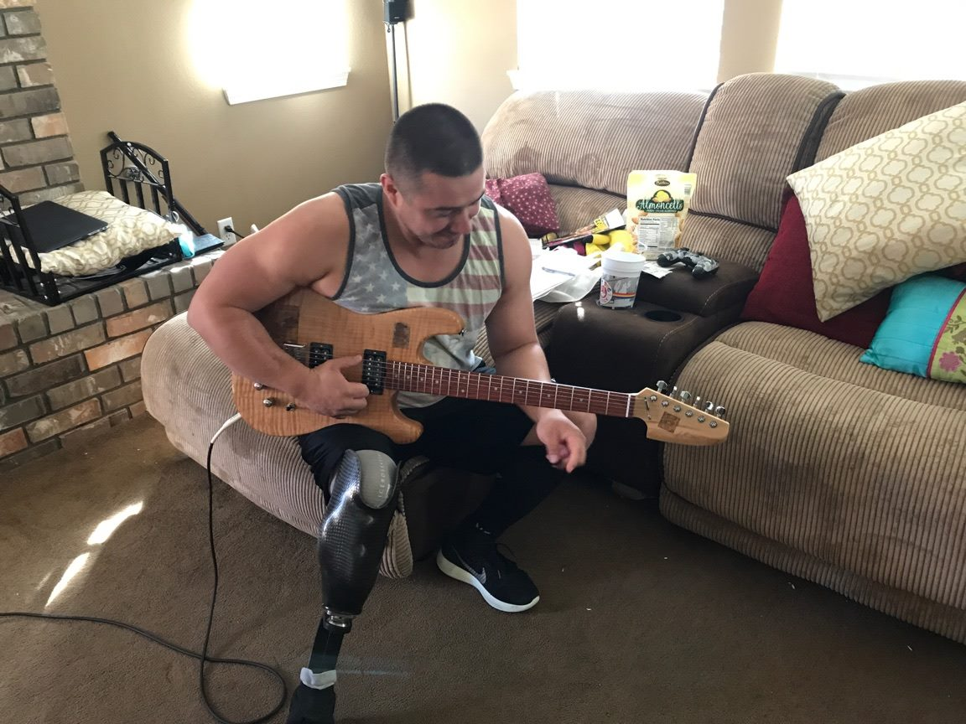
PROGRAMS
Music Education. Enable HEROES to learn music theory and instrumentation (i.e. music lessons).

Slide 6
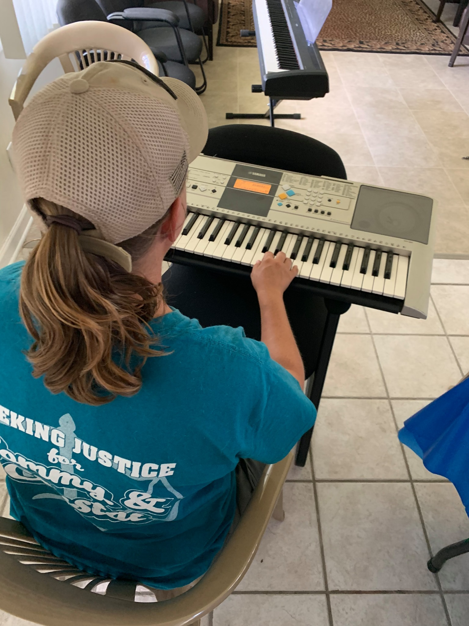
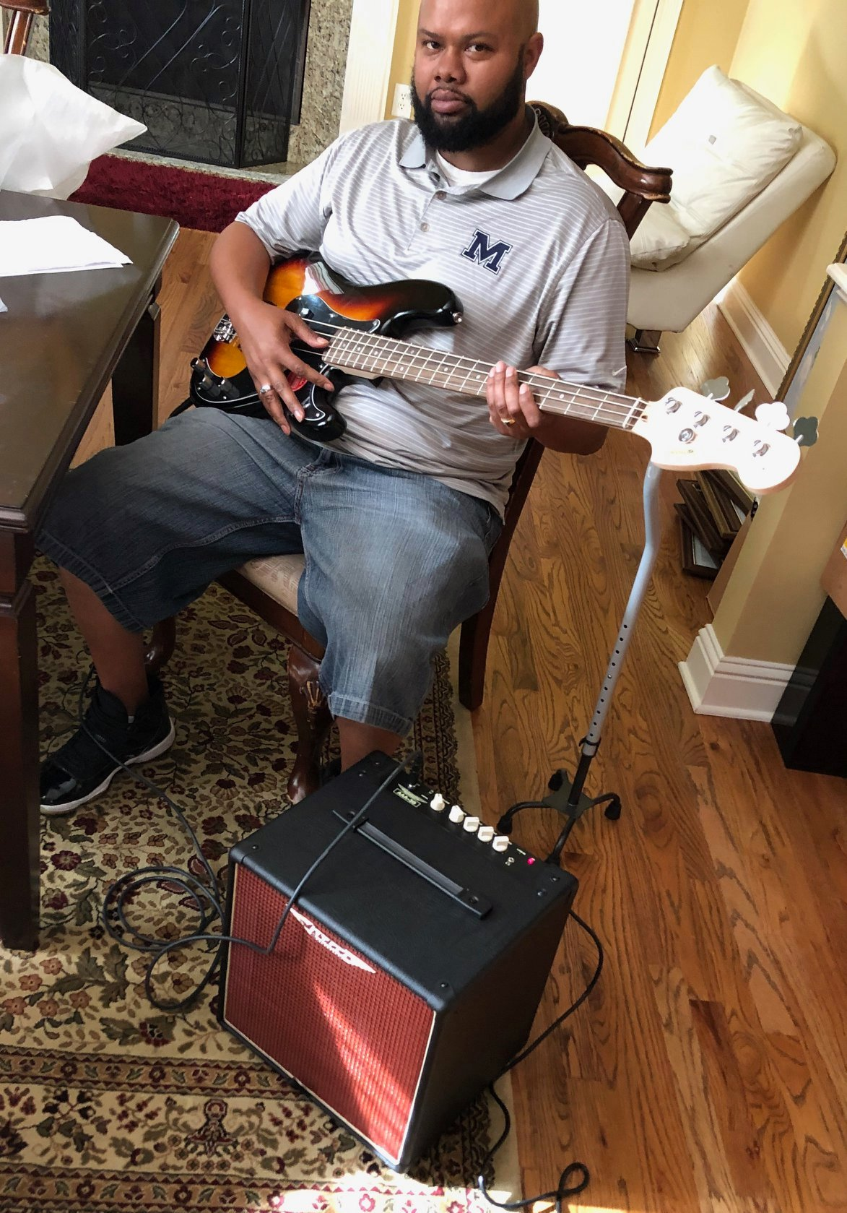
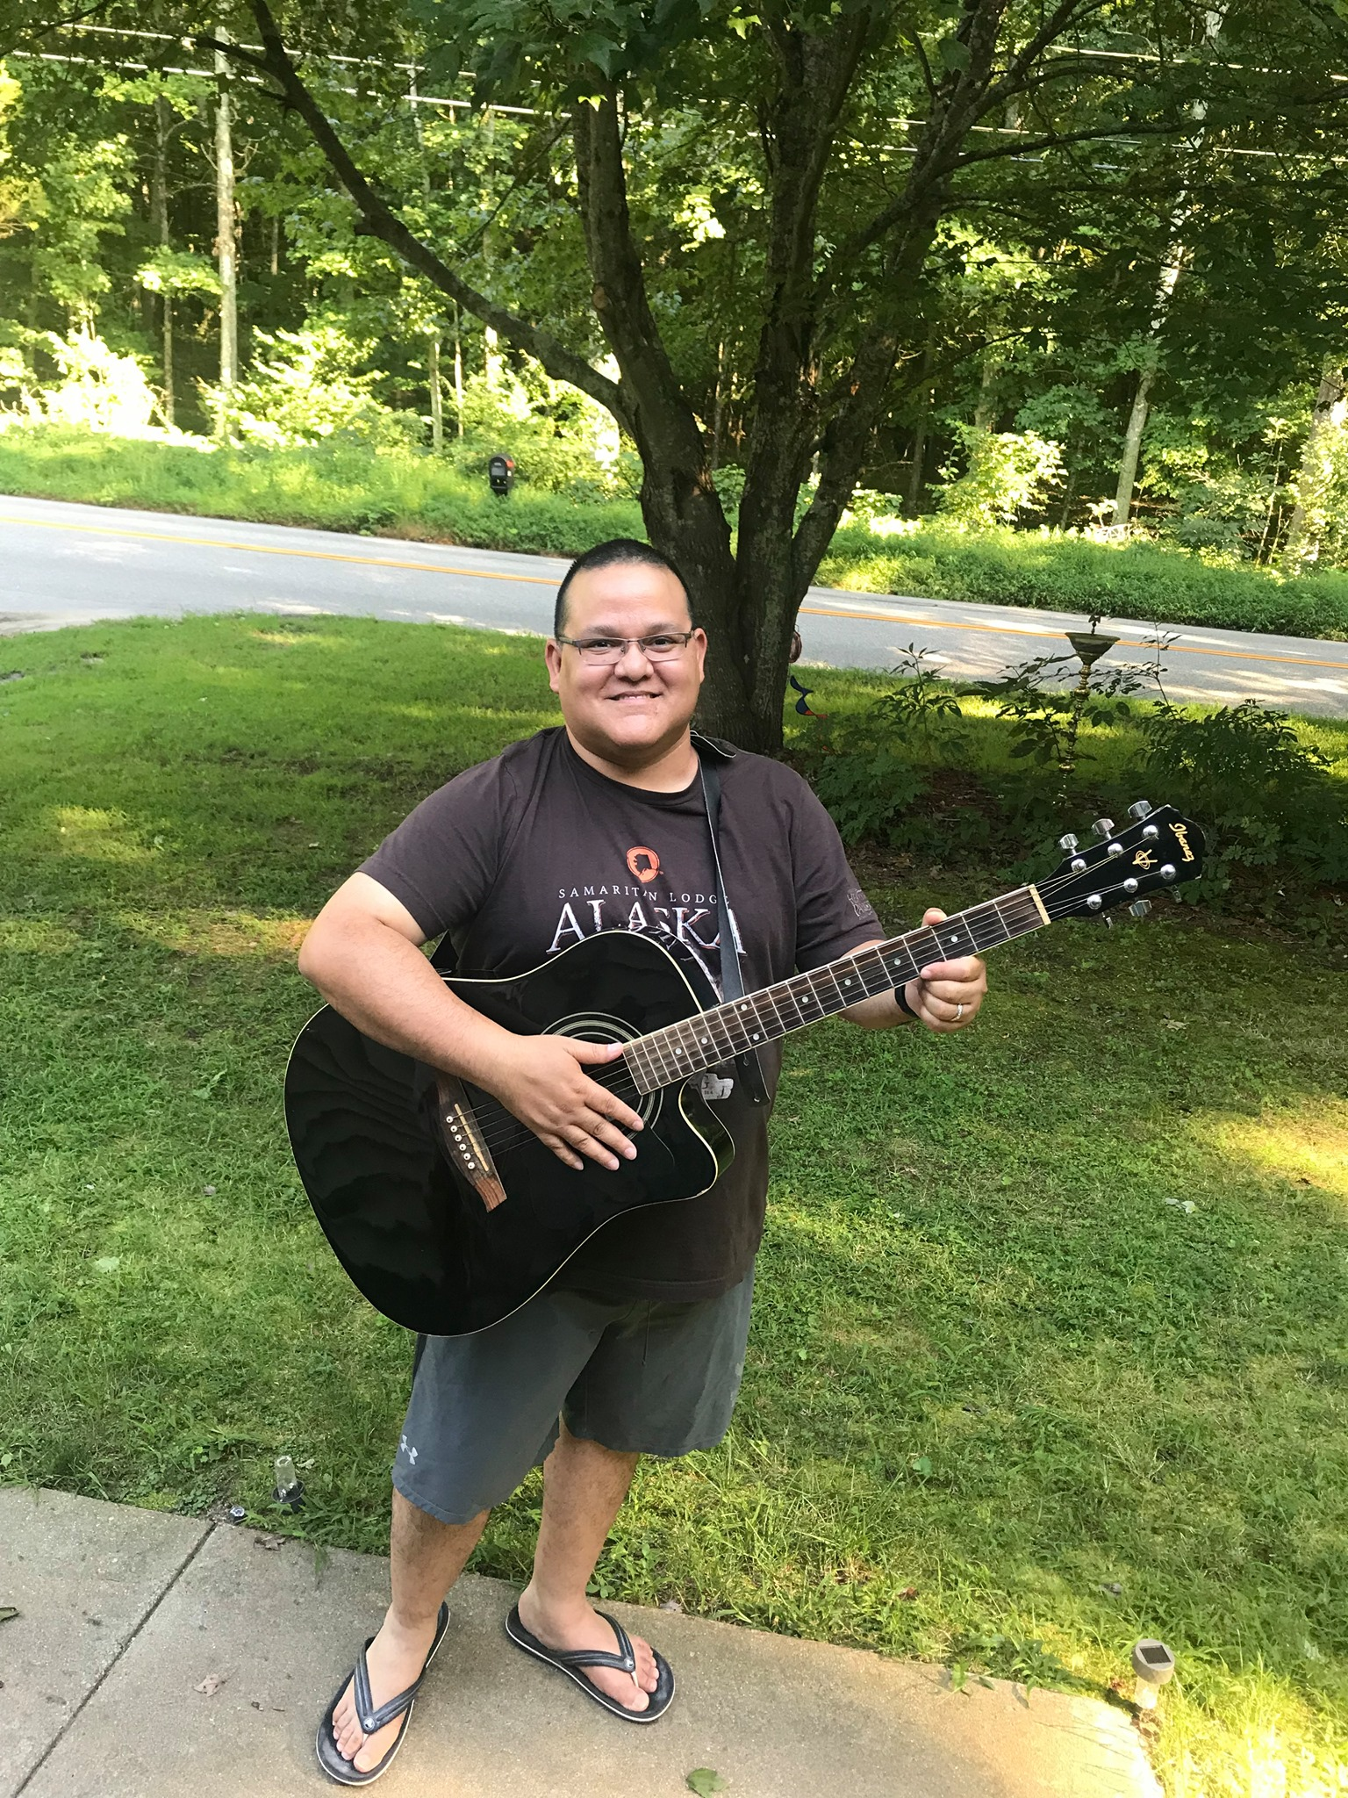
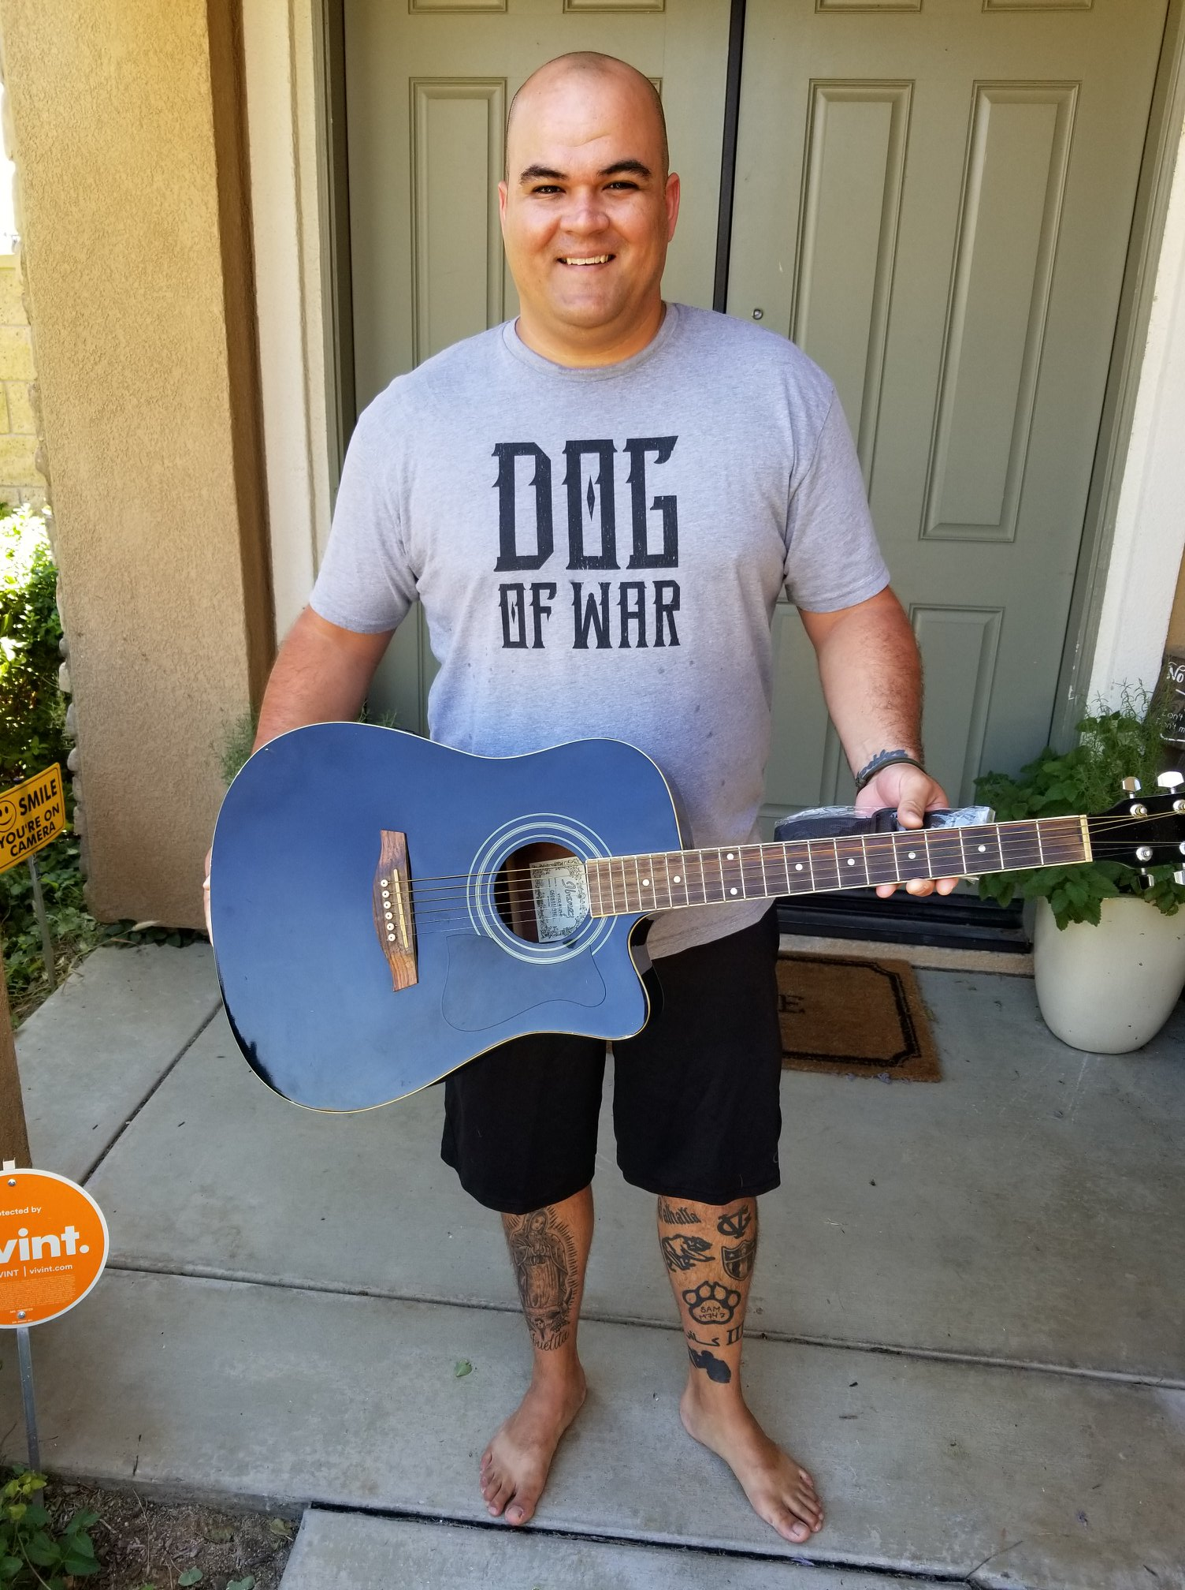
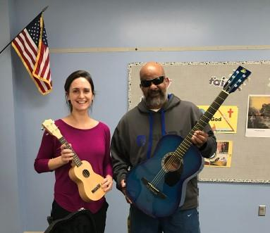
PROGRAMS
Music Grants. Provide financial aid and resources for HEROES to participate in music programs.

Slide 7
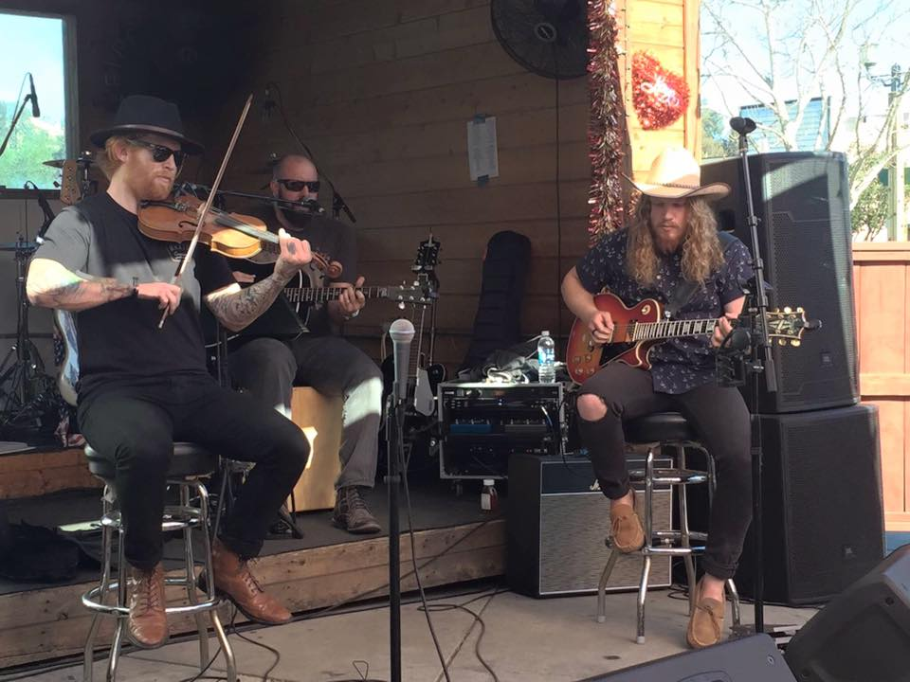
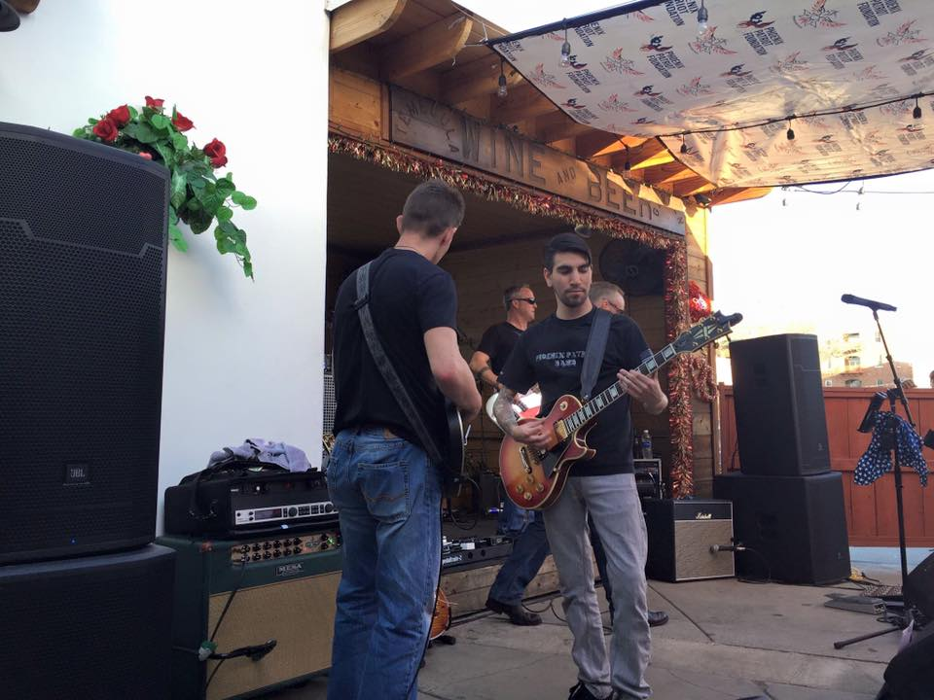
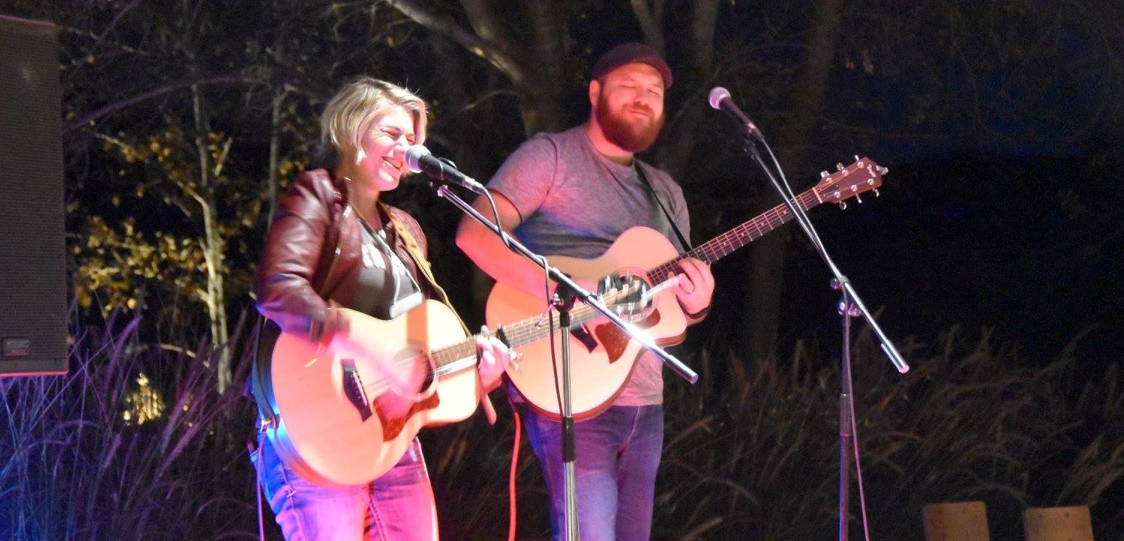
PROGRAMS
Performance Opportunities. Provide live music venues for HEROES to perform music.

Slide 8
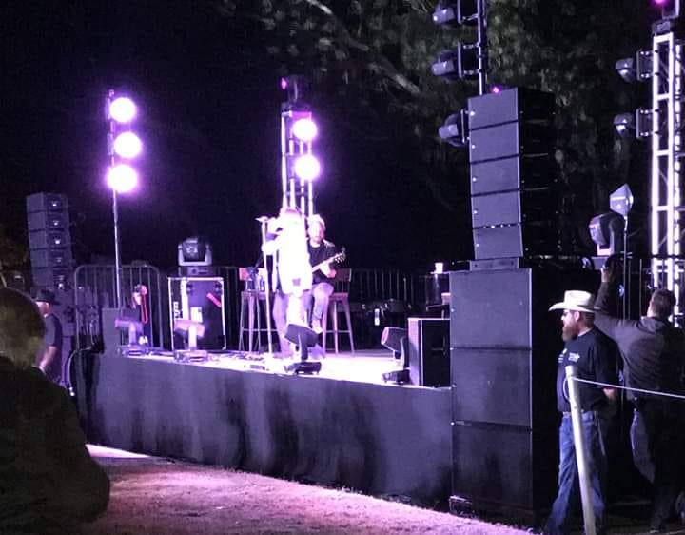
PROGRAMS
Music Industry Support. Provide employment opportunities for HEROES within the music industry.

Slide 9
PROGRAMS
Original Music/Album Support. Provide resources and venues (i.e. studios/musicians) to aid HEROES in producing and recording their own original music.

Slide 10
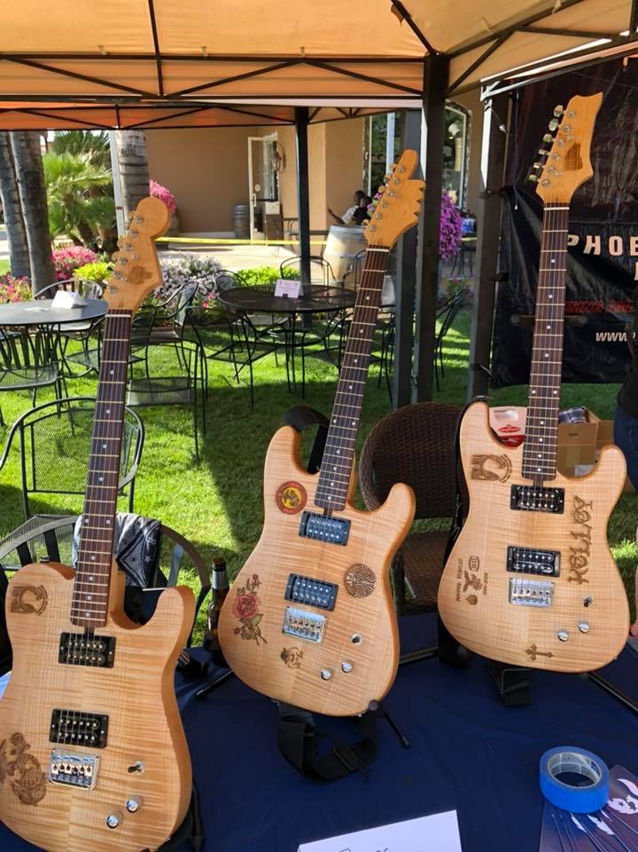
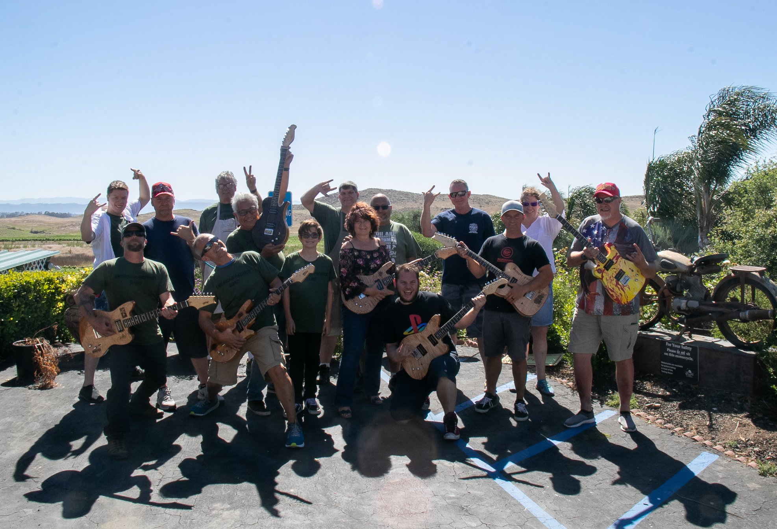
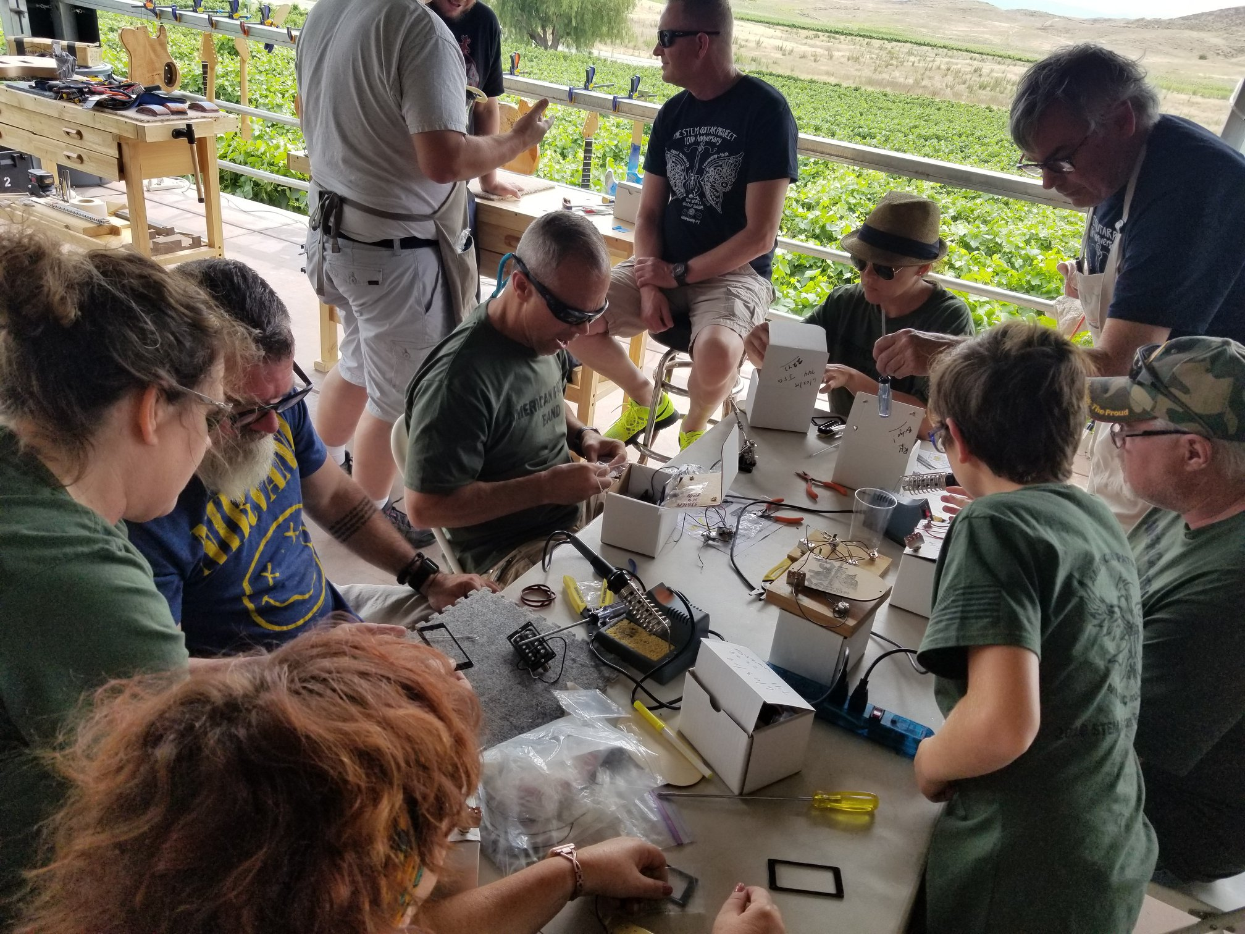
PROGRAMS
Guitar Building Workshops. Enable heroes to build their own custom guitars with families and other HEROES.

Slide 11
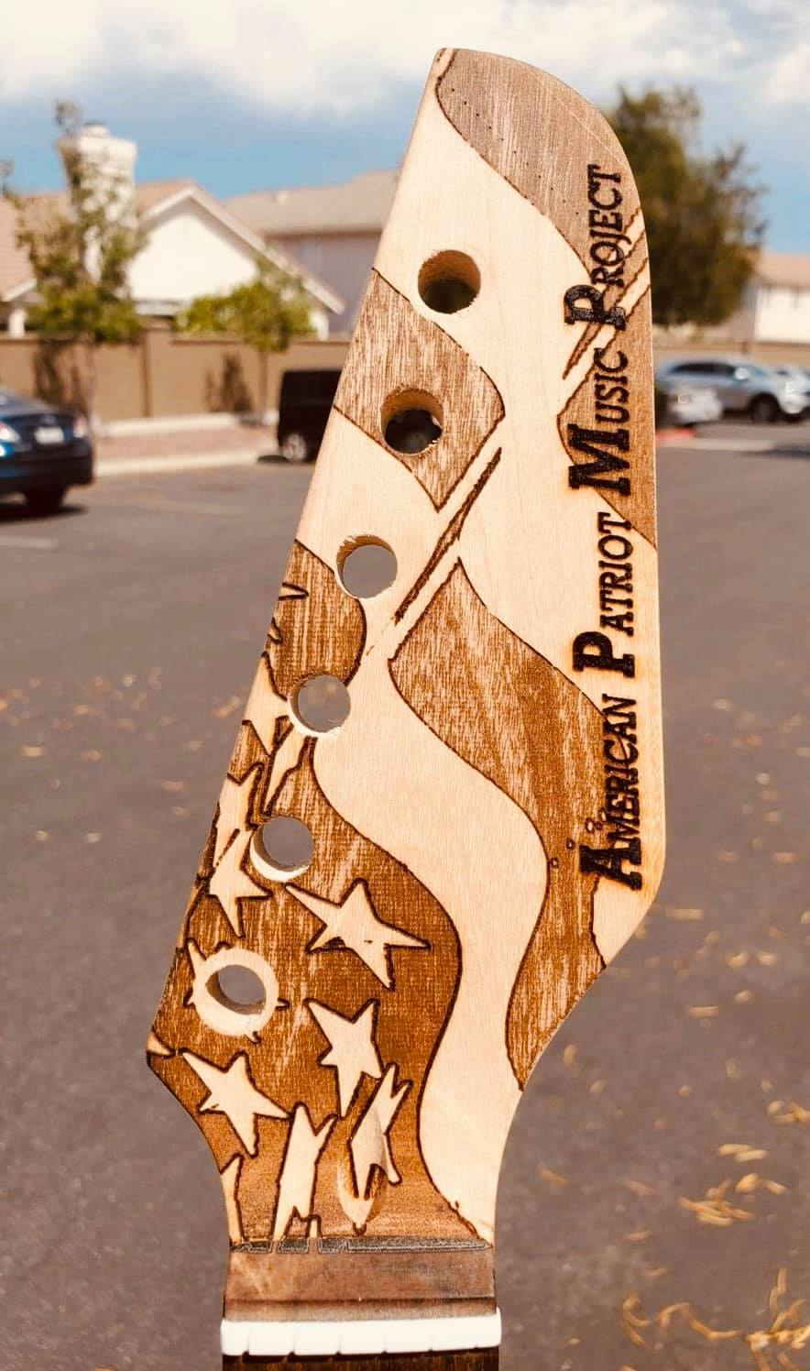
PROGRAMS
Custom Signature Series Guitar. APMP production of unique veteran built custom signature guitar line for marketing/fundraising goals.

Slide 12
AMERICAN PATRIOT BAND
Serves as primary marketing/fundraising platform
Music band that performs all genre of rock, alternative, and country
Band members work with heroes on and off stage

Slide 13
METRICS
52 HEROES Served
11 Music Grants Executed (instruments gifted)
13 Custom Guitar Building Workshops Conducted
2 Original Music Projects (album/studio support)
2 Music Lesson Projects Conducted

Slide 14
CONTACT INFORMATION
Website: www.AmericanPatriotMusic.org
Email: info@AmericanPatriotMusic.org
Phone: 909.908.2480
Social Media:
- Facebook: @AmericanPatriotMusic
- Instagram: @americanpatriotmusic
- Twitter: @AmPatMusic
- YouTube: American Patriot Music Project Channel

